Slide 1

Nick Pease, Stephen Goodridge, Clark LaChance, Joseph Gallant, Aidan Bradley
25 April 2024
Notes:
Clark

Slide 2
Overview
Web-based social networking service
www.chatma.ps
Connect with others in your local geographical area
Features an interactive map showing general location relative to users + rooms
Open chat rooms to start public conversations based on specific topics
Registered users can create their own chat room
Create topics of interest for others to view or join
Features direct messages between users
Our aim is community engagement, meaningful interactions, and a new way to meet others
Notes:
Clark

Slide 3
User Stories
As a registered user, I want to be able to view chat rooms near me so that I can talk to people in my community.
As a registered user, I want to be able to create my own chat room so that I can talk with friends in private.
As a registered user, I want to be able to include my personal interests in my profile so that I can find like minded people.
As a registered user, I want to be able to appear offline so that I won't be disturbed.
As a registered user, I want to be able to filter my search for chat rooms by using keywords so that I can find where I belong.
Notes:
Joe G - 30 - 40s

Slide 4
User Stories
As a registered user, I want to be able to add other users so that I can reach out to them in the future.
As a registered user, I want the ability to delete previous messages that I sent in the case that I mistakenly wrote to the wrong chat.
As a registered user, I want to receive chat notifications so that I can respond back promptly to friends.
As a registered user, I want to be able to send direct messages to other users so that I can chat with them in private.
As a registered user, I want to be able to view who’s online so that I know who I can chat with.
Notes:
Joe G

Slide 5
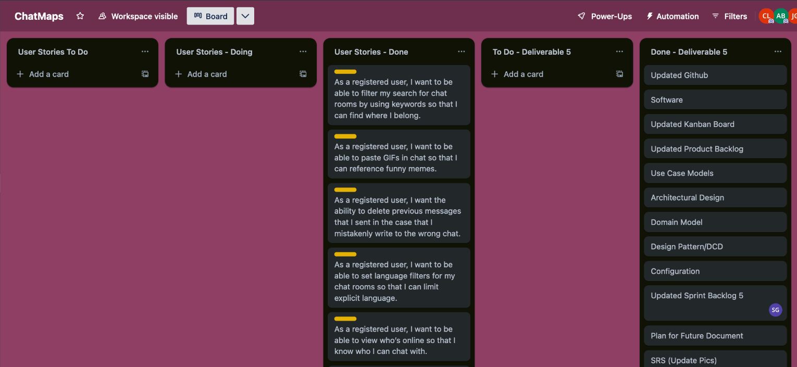
Kanban Board
Kanban Board
Notes:
Clark: Used a to-do, doing, and done for user stories. Created a To-do/Done lists for each deliverable and archived after it was submitted. End of deliverable 5 seen here.

Slide 6
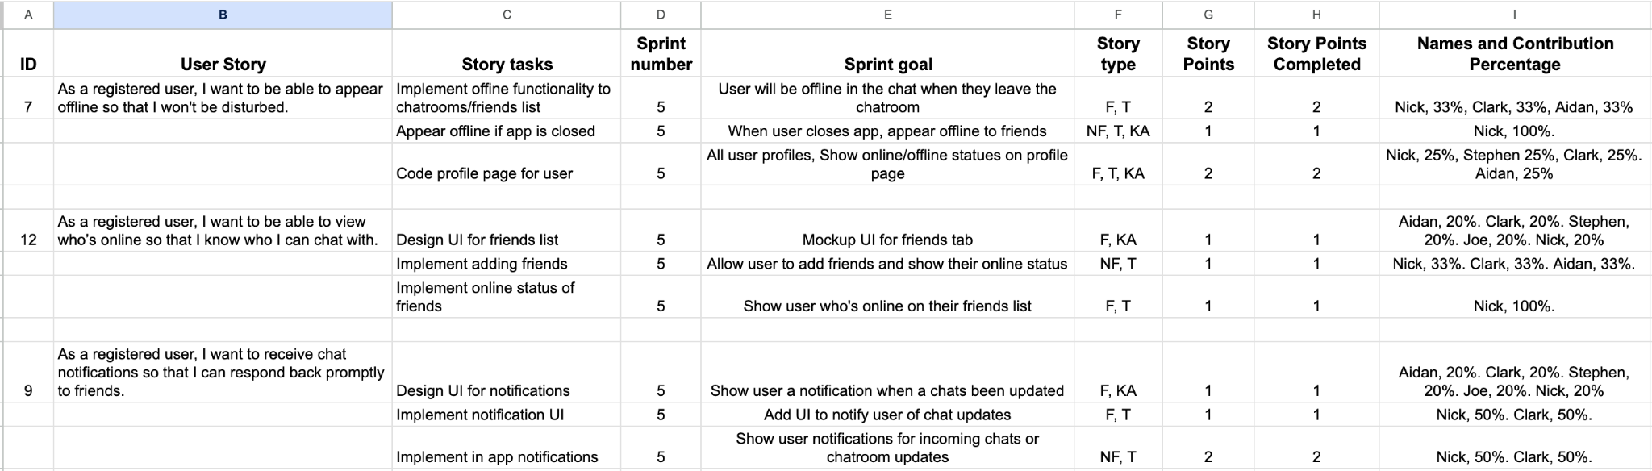
Sprint Backlog
Notes:
Stephen

Slide 7
Product Backlog
Completed User Stories:
As an unregistered user, I want to be able to view chat rooms near me so that I can talk to people in my community.
As a registered user, I want to be able to include my interests in my profile so that like minded people can find me.
As a registered user, I want to be able to create my own chat room so that I can talk with friends in private.
As a registered user, I want to be able to add other users so that I can reach out to them in the future.
As a registered user, I want the ability to delete previous messages that I sent in the case that I mistakenly write to the wrong chat.
As a registered user, I want to be able to filter my search for chat rooms by using keywords so that I can find where I belong.
As a registered user, I want to be able to appear offline so that I won't be disturbed.
As a registered user, I want to be able to see a short list of users when I hover over a chat so that I can see if I know anyone.
As a registered user, I want to receive chat notifications so that I can respond back promptly to friends.
As a registered user, I want to be able to paste GIFs in chat so that I can reference funny memes.
As a registered user, I want to be able to send direct messages to other users so that I can chat with them in private.
As a registered user, I want to be able to view who’s online so that I know who I can chat with.
As a registered user, I want to be able to set language filters for my chat rooms so that I can limit explicit language.
As a registered user, I want to be notified when a new user joins the chat so that I can greet them.
As a registered user, I want to be able to logout of my account at any time so that I can keep my messages secure.
As a registered user, I want to be able to visually see how big a chat room is so that I can avoid busy chat rooms.
(Bolded stories indicate stories with particular importance to the usability of the application)
Notes:
Clark

Slide 8
Functional Requirements
The system shall let users create chat rooms with a specific topic, for other users in the area to join.
The system shall show users a local map of their area.
The system shall have the option to create private chat rooms which can only be accessed by invitation.
The system shall keep users personal information on their account private.
The system shall allow users to customize their profile.
Notes:
Joe G

Slide 9
Non-Functional Requirements
The system shall be available at all hours of the day 99% of the time.
The system shall provide users real-time location updates every 5 minutes 95% of the time.
The system shall be capable of keeping users’ information private 99% of the time.
The system shall comply with relevant laws and regulations, such as data protection regulations 99% of the time.
The system shall handle sending messages within 5 seconds 95% of the time.
Notes:
Joe G

Slide 10
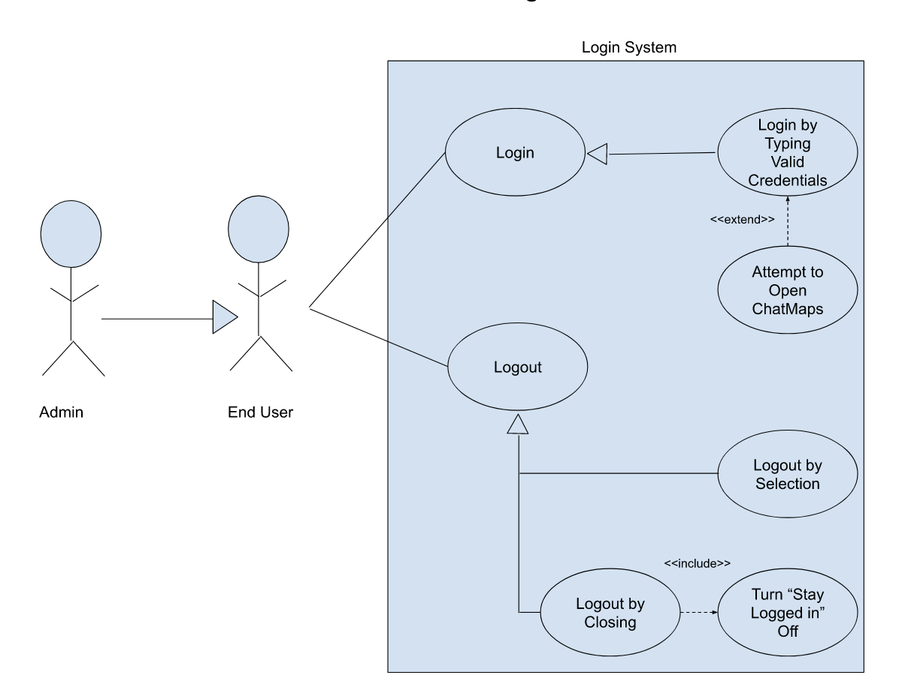
Use Case 1
Login System
Logging in is a requirement to access main features of ChatMaps System.
It’s important to handle logins and logouts appropriately without security risks.
When logging out, terminating the current session is ideal to prohibit others from accessing your account on the same computer.
Logging in can be done by providing the correct credentials that matches the information on our server.
Logging out can be done by clicking the logout button or simply by closing the browser.
Notes:
Joe G

Slide 11
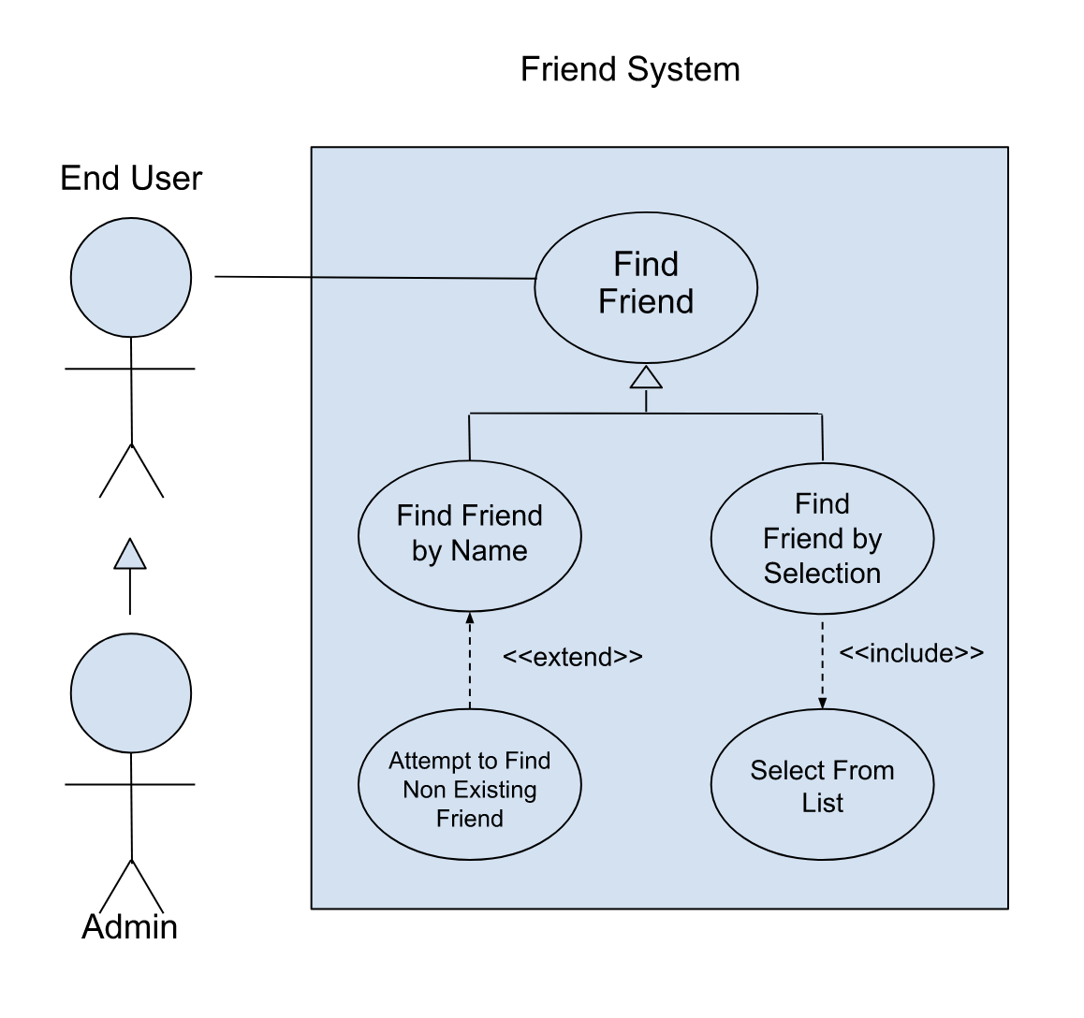
Use Case 2
Friend System
Friends are an important part of any social network and can increase user engagement and retention.
This exact friend system was not implemented completely as of 25 APR 2024. Friend lookup by username is a planned feature for forward releases.
Adding a friend can be done by accessing the users profile and pressing the Add Friend button.
In this use case, you may lookup a username to see if it exists, or select one from a list of all users
Notes:
Aidan B

Slide 12
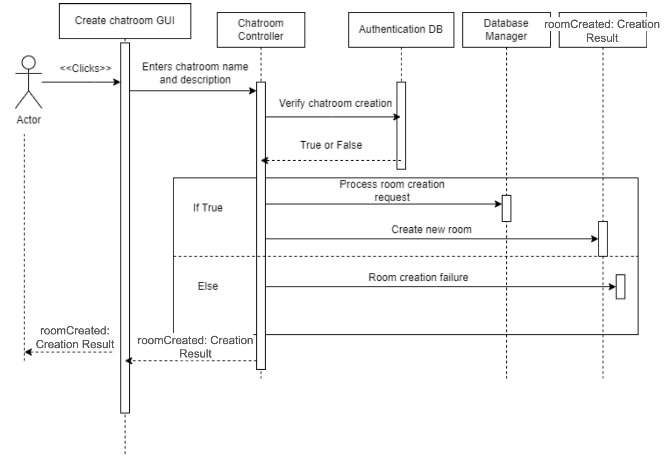
Sequence Diagram 1
Creating a chat room, while a benign feature, requires a fair amount of computation and verification as to prevent unauthorized tampering with the application, spam room generation, or overload of DB or Authentication services.
Every time a chat room is created, the user is authenticated to ensure currency on its current authorization
If authorization succeeds, the room is created and stored in the proper place in the database
If authentication fails, the user is redirected to the authentication flow to process a new authentication.
Notes:
Stephen g

Slide 13
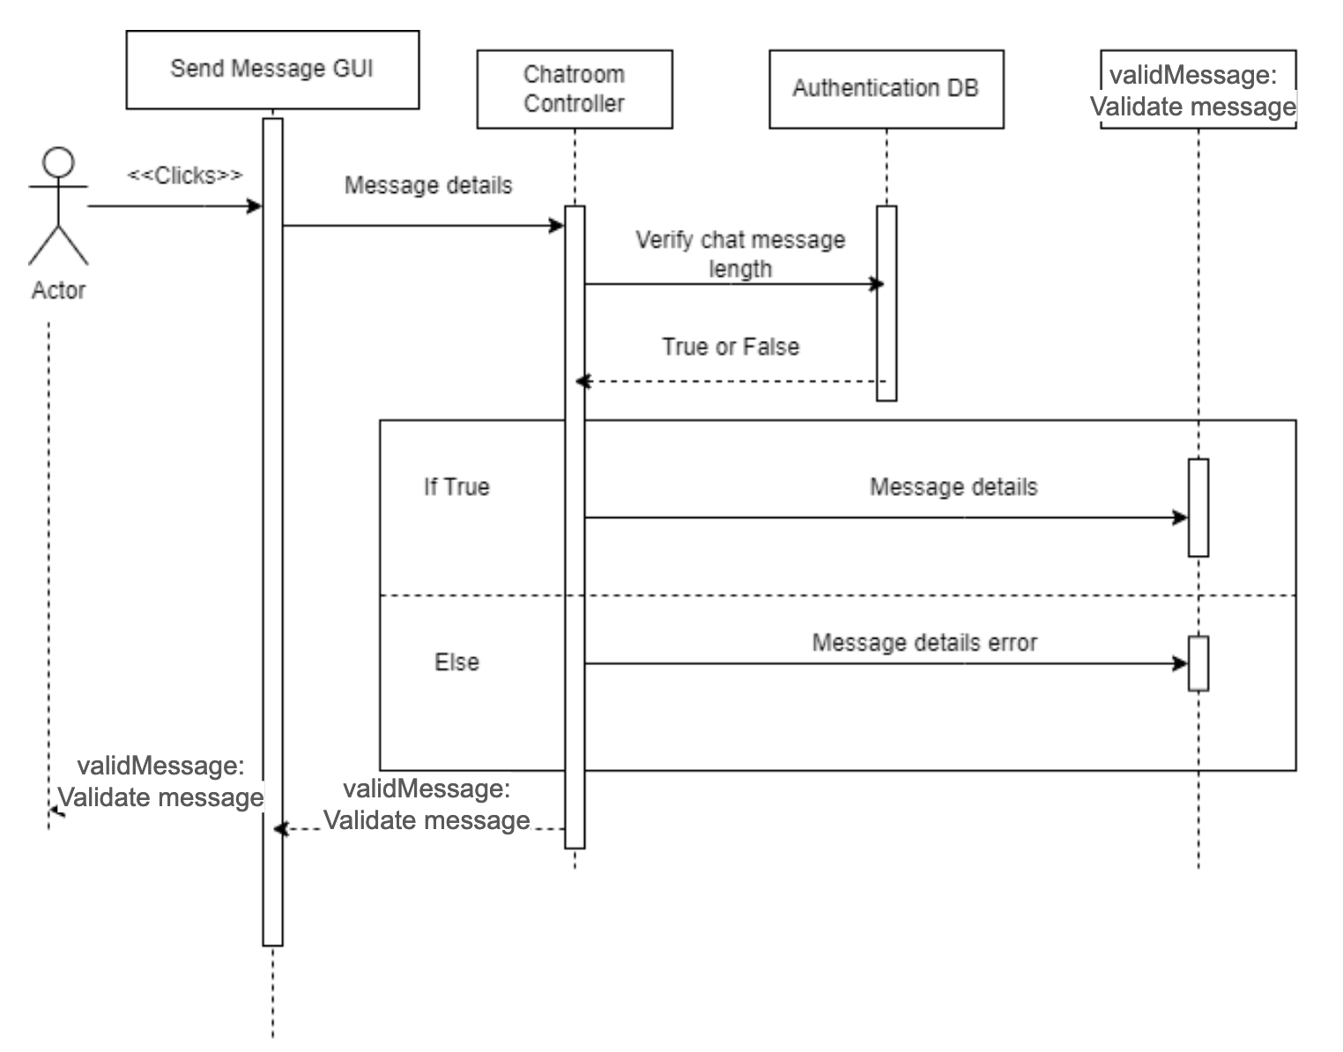
Sequence Diagram 2
Sending a message is crucial to the fundamental operation of this software.
Sending a message primarily involves verifying that the length of the message is in accordance with the max storage size of the database
Once that verification succeeds, the message is uploaded to the database and distributed to all clients currently connected to its corresponding chatroom
The user can confirm this by ensuring that the message is evident on their screen.
Notes:
Stephen G

Slide 14
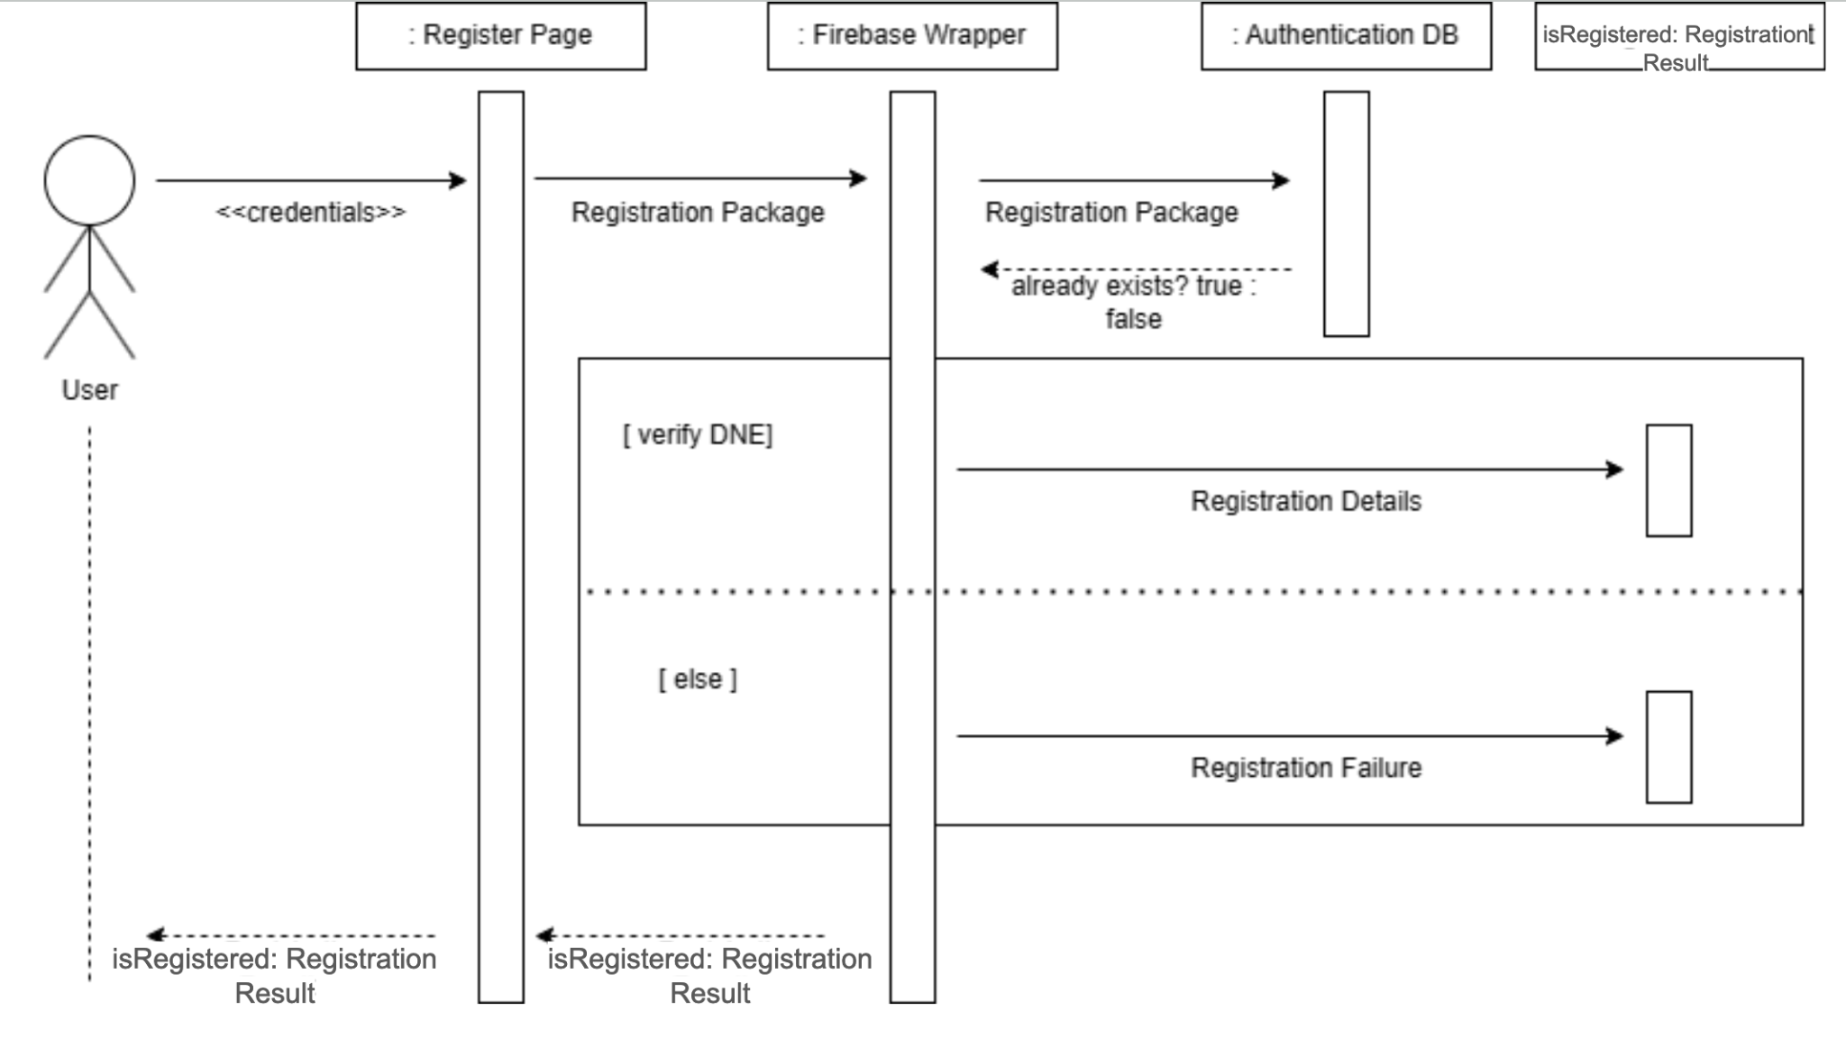
Sequence Diagram 3
Registration
Notes:
Stephen G

Slide 15
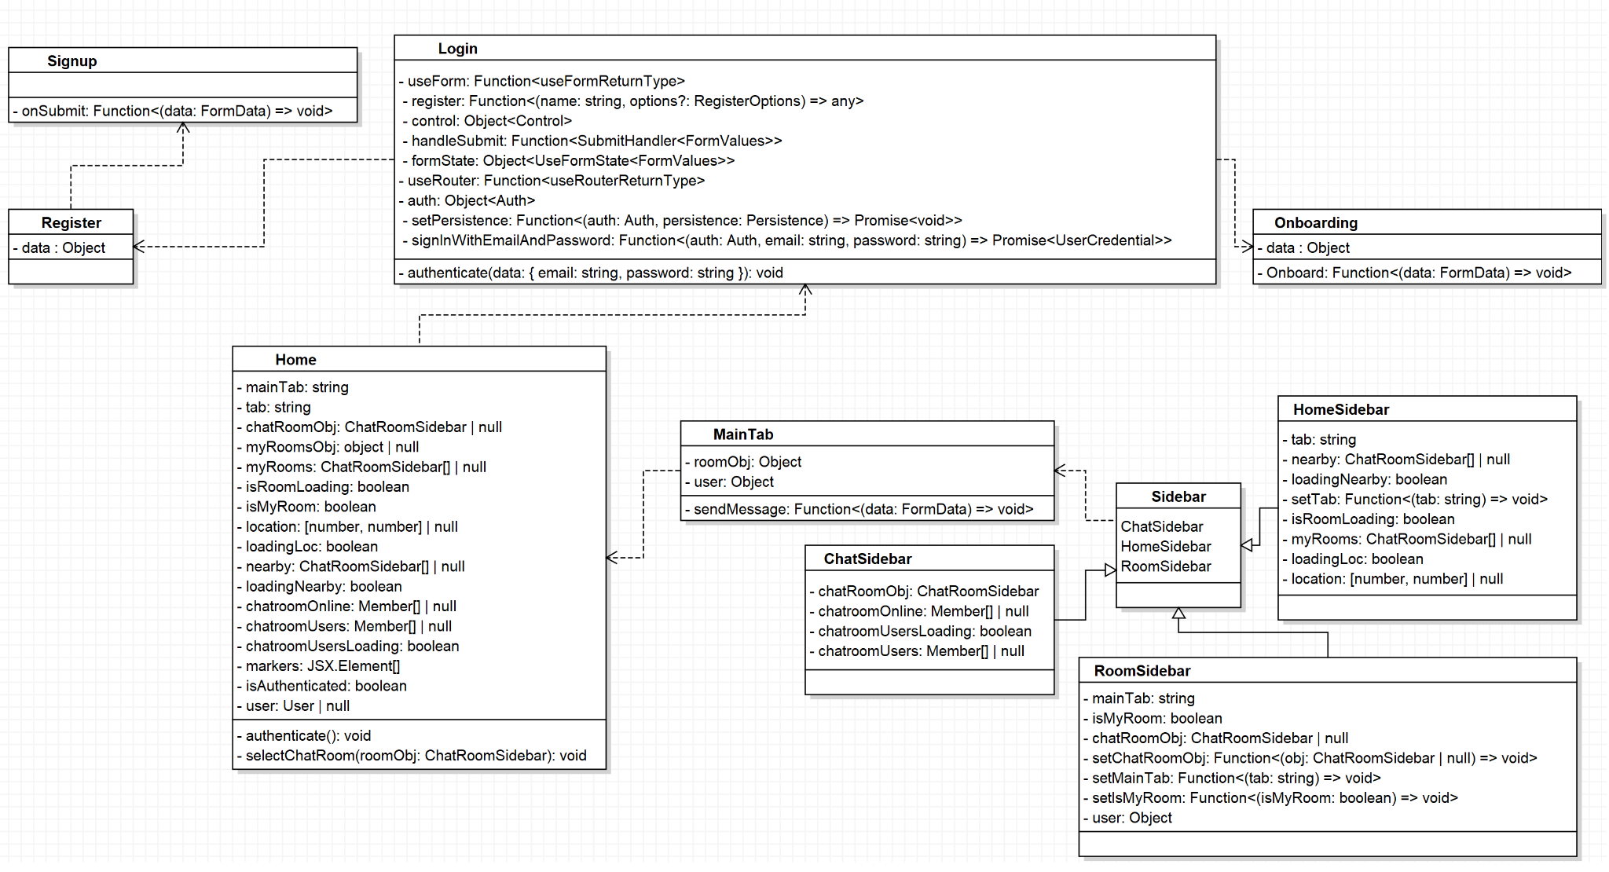
Domain Model
Notes:
Aidan B

Slide 16
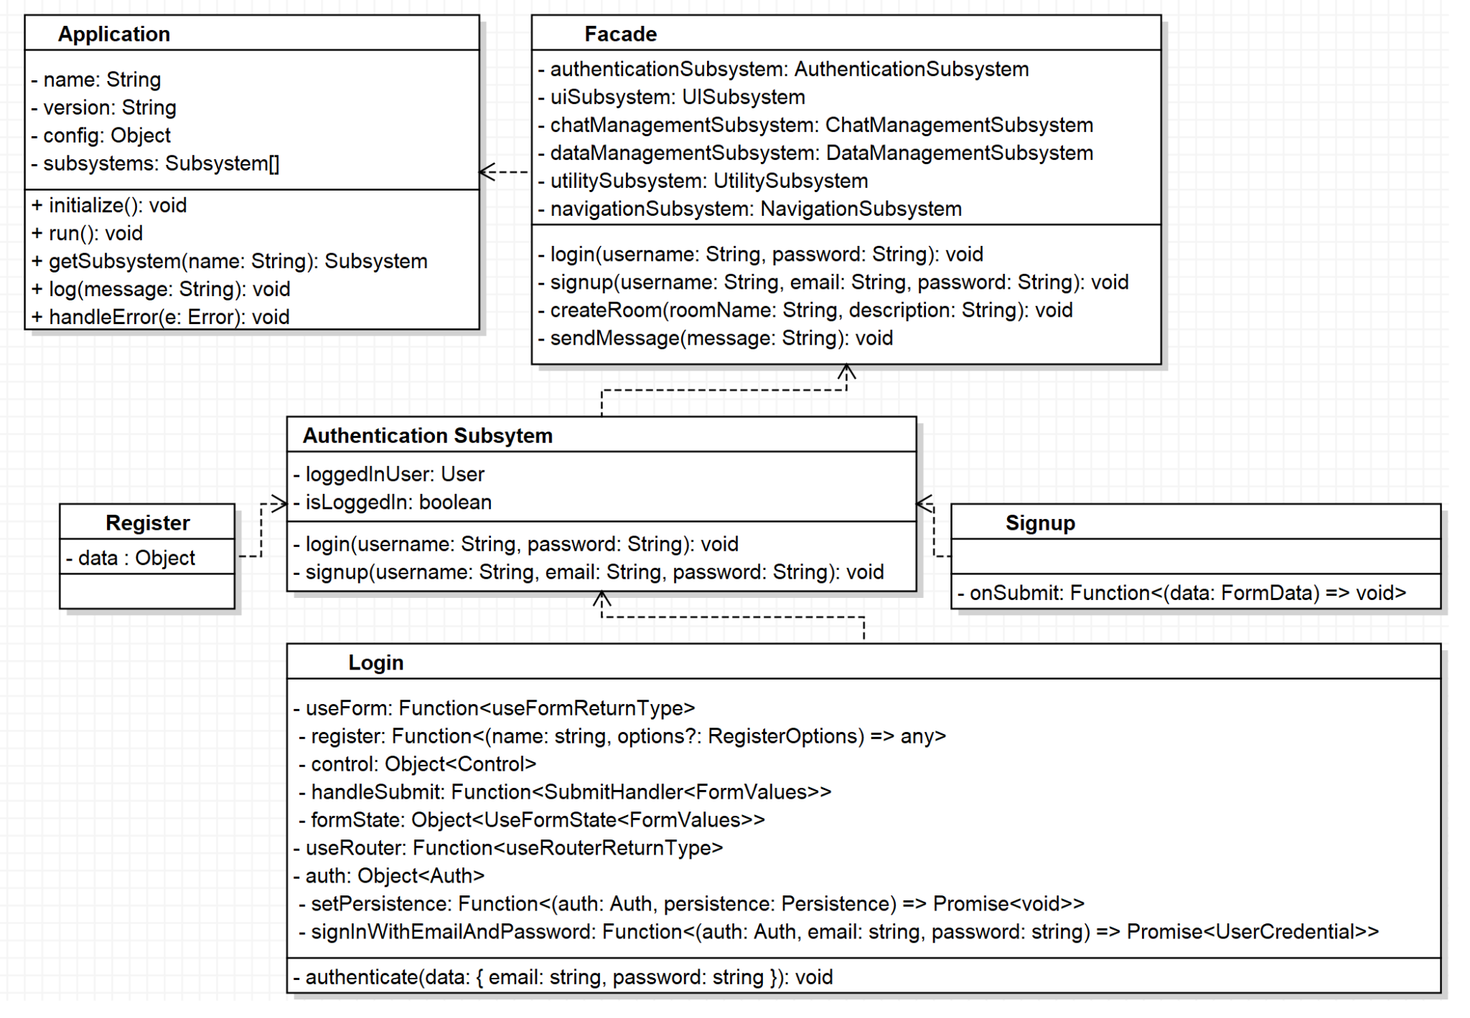
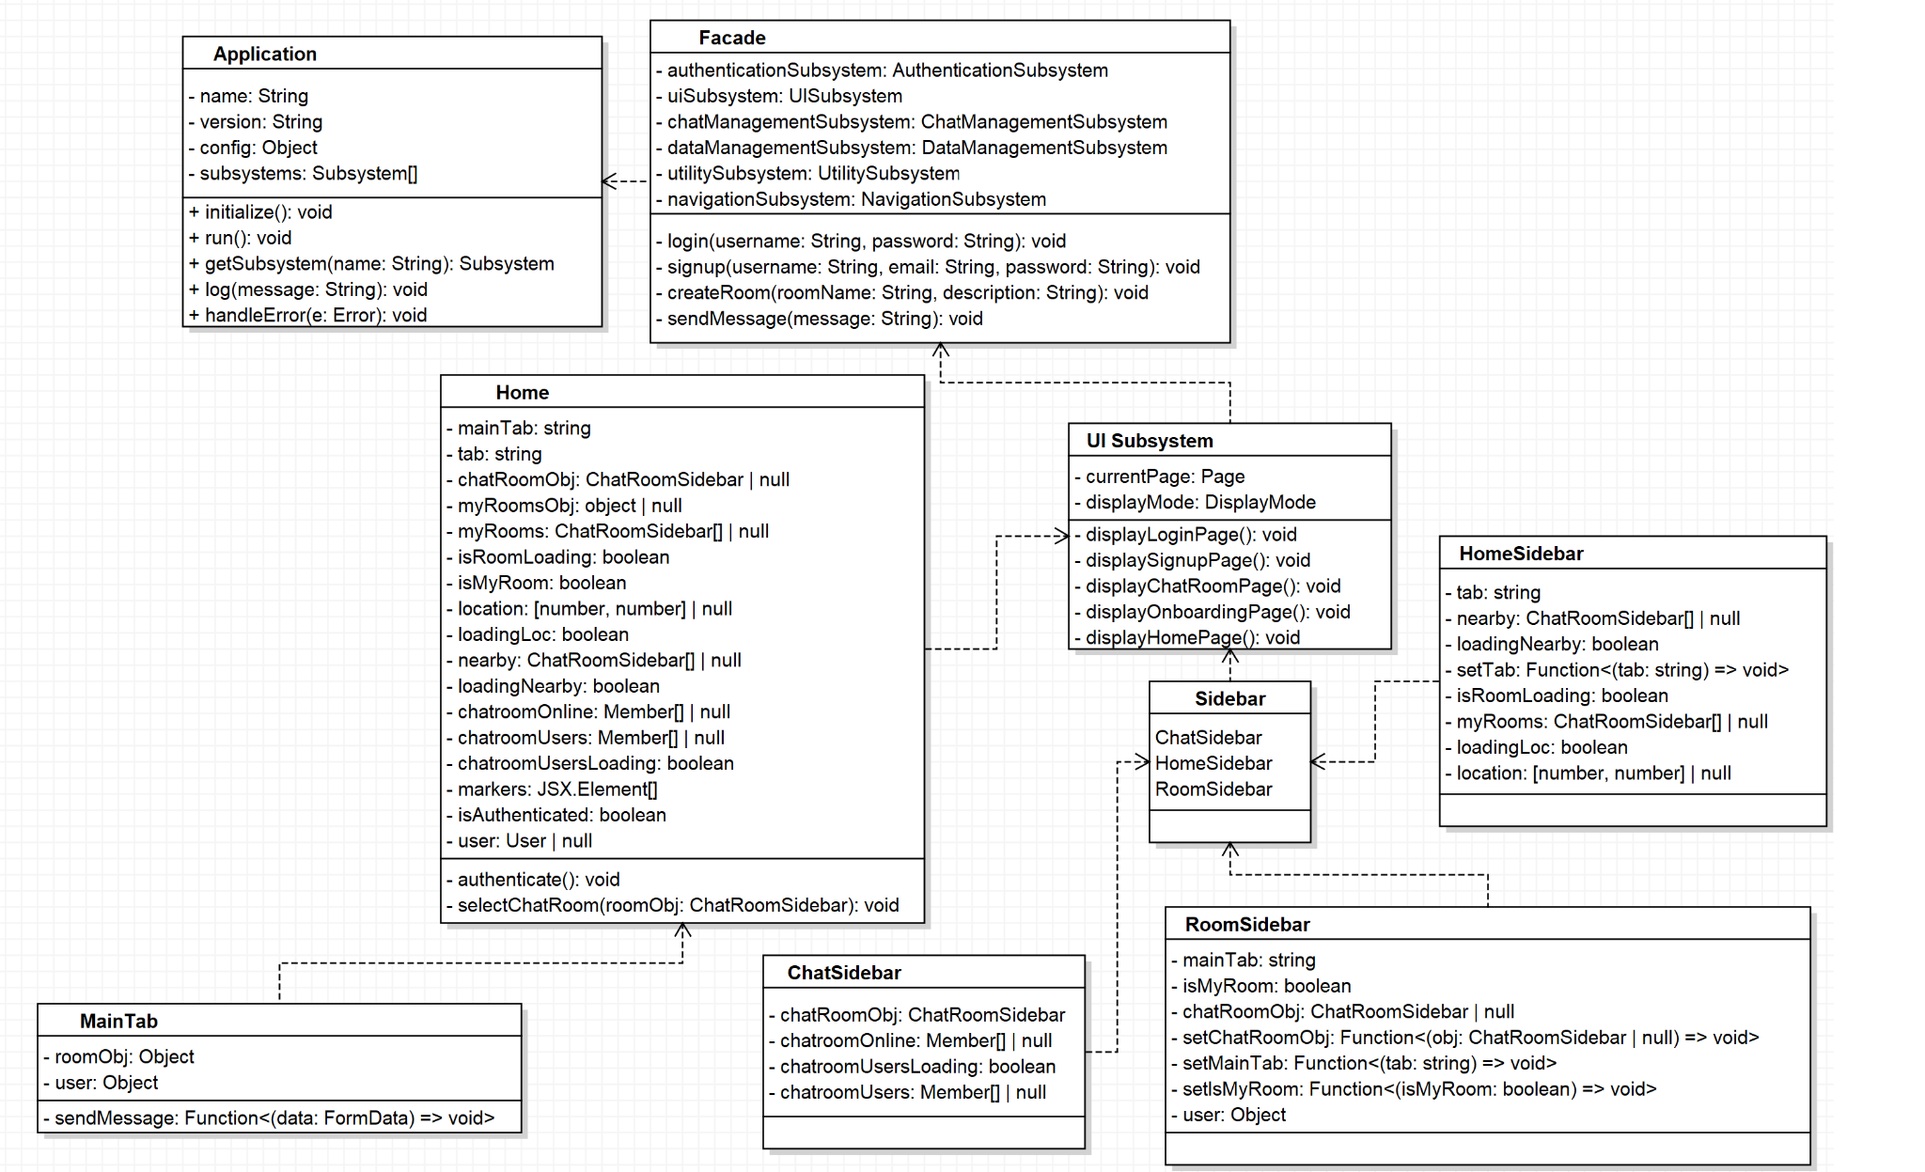
Design Class Diagrams
Authentication
User Interface
Notes:
Aidan B

Slide 17
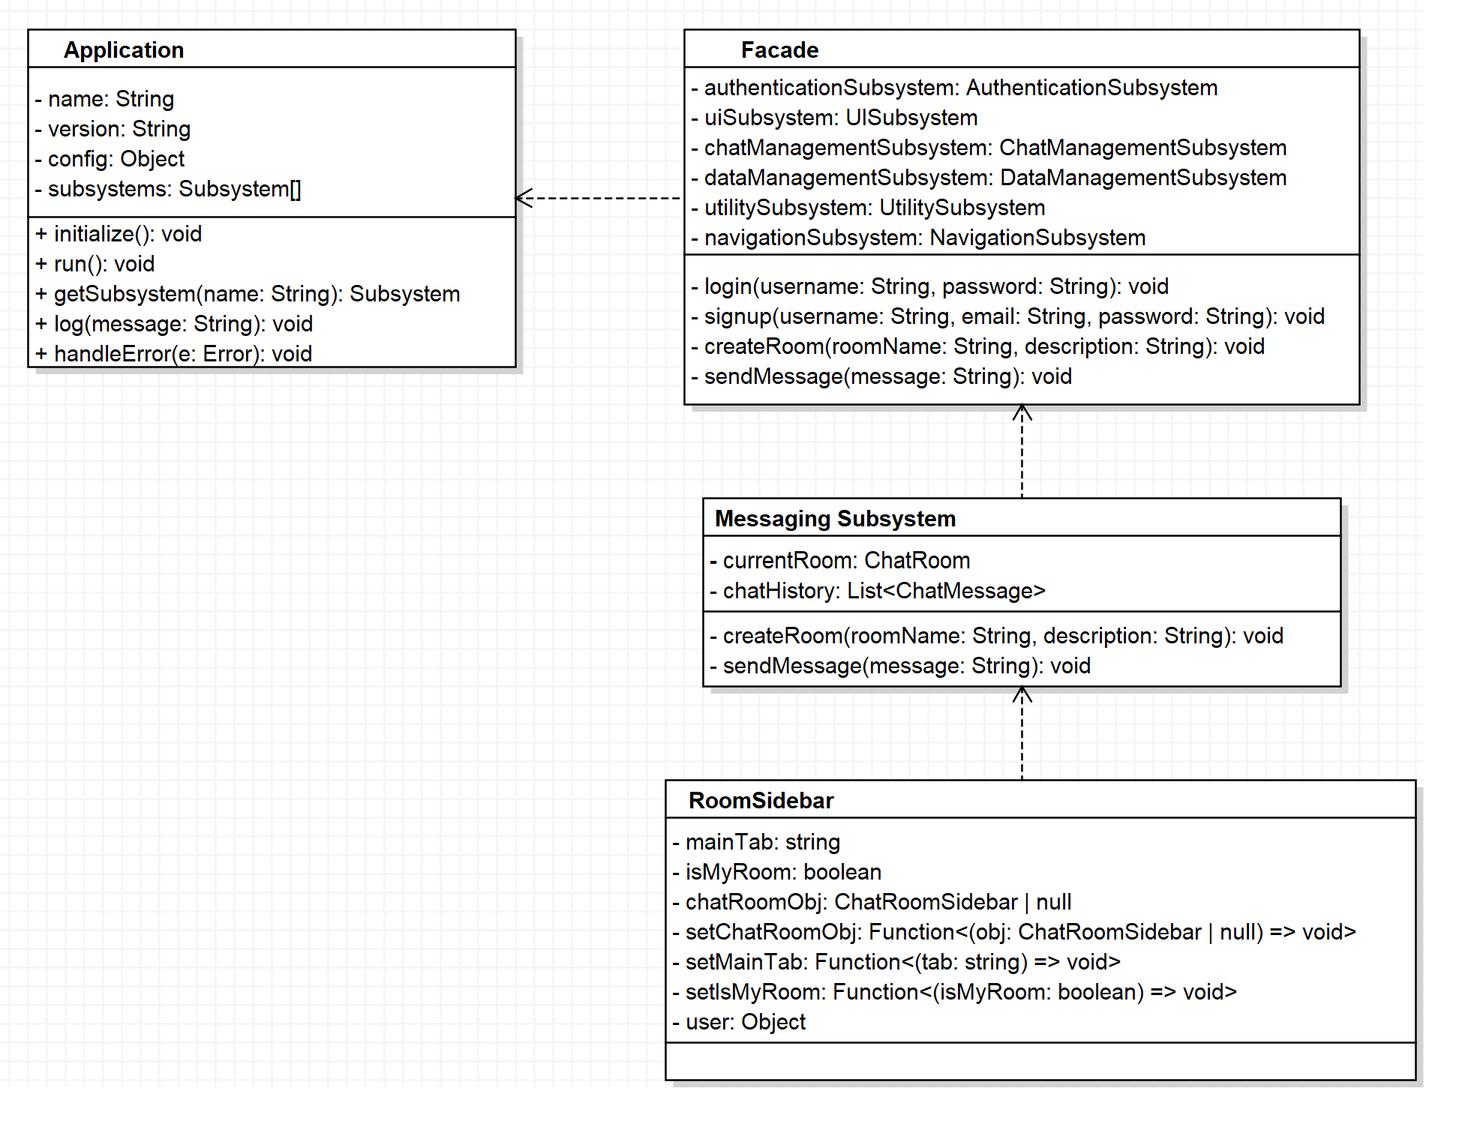
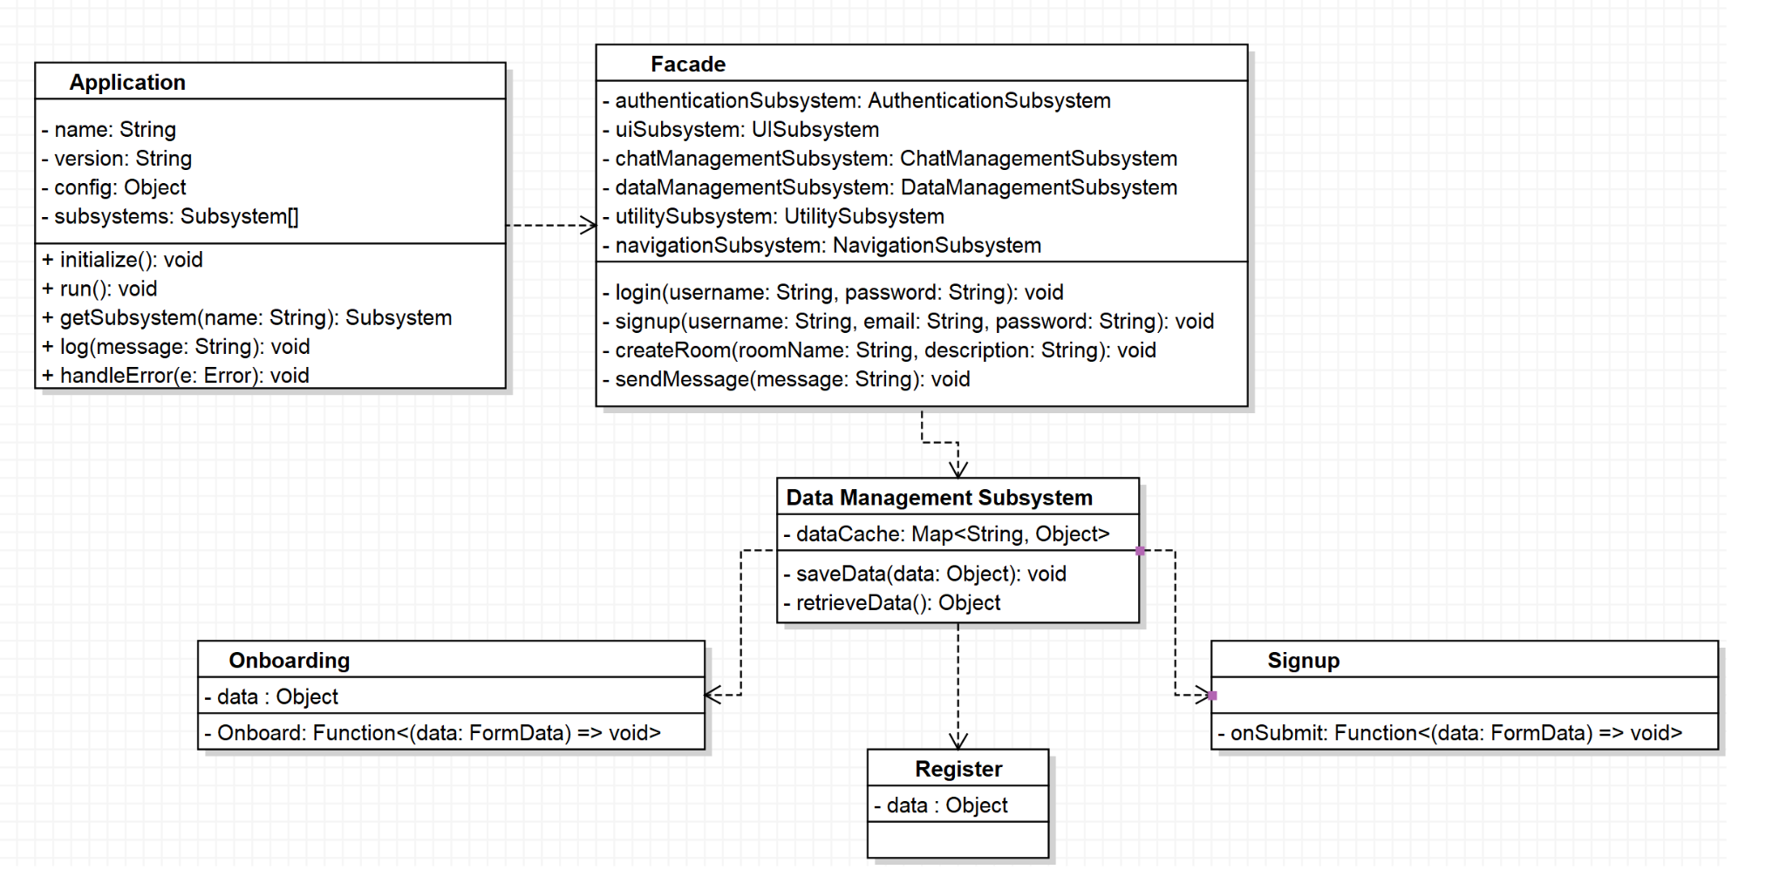
Design Class Diagrams
Data Management
Messaging
Notes:
Aidan B

Slide 18
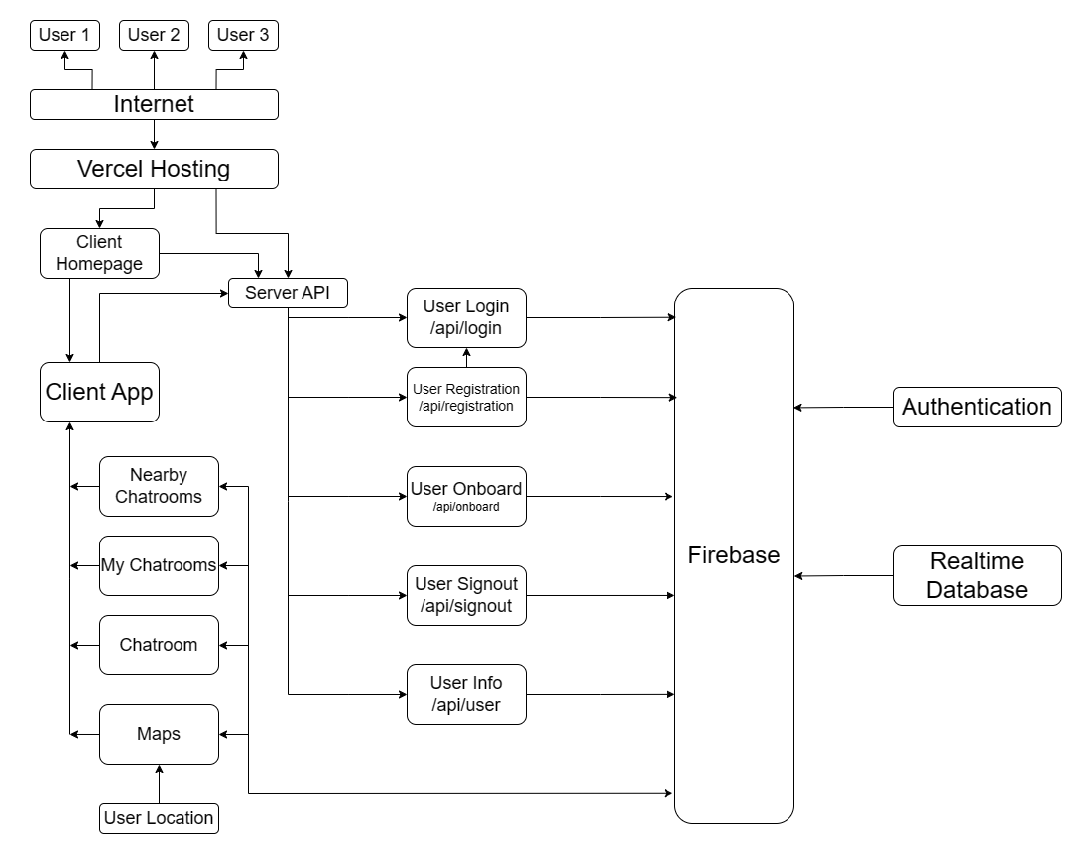
Architecture
Notes:
Nick P - Spend a lil time on this, easiest diagram to understand in this whole presentation

Slide 19
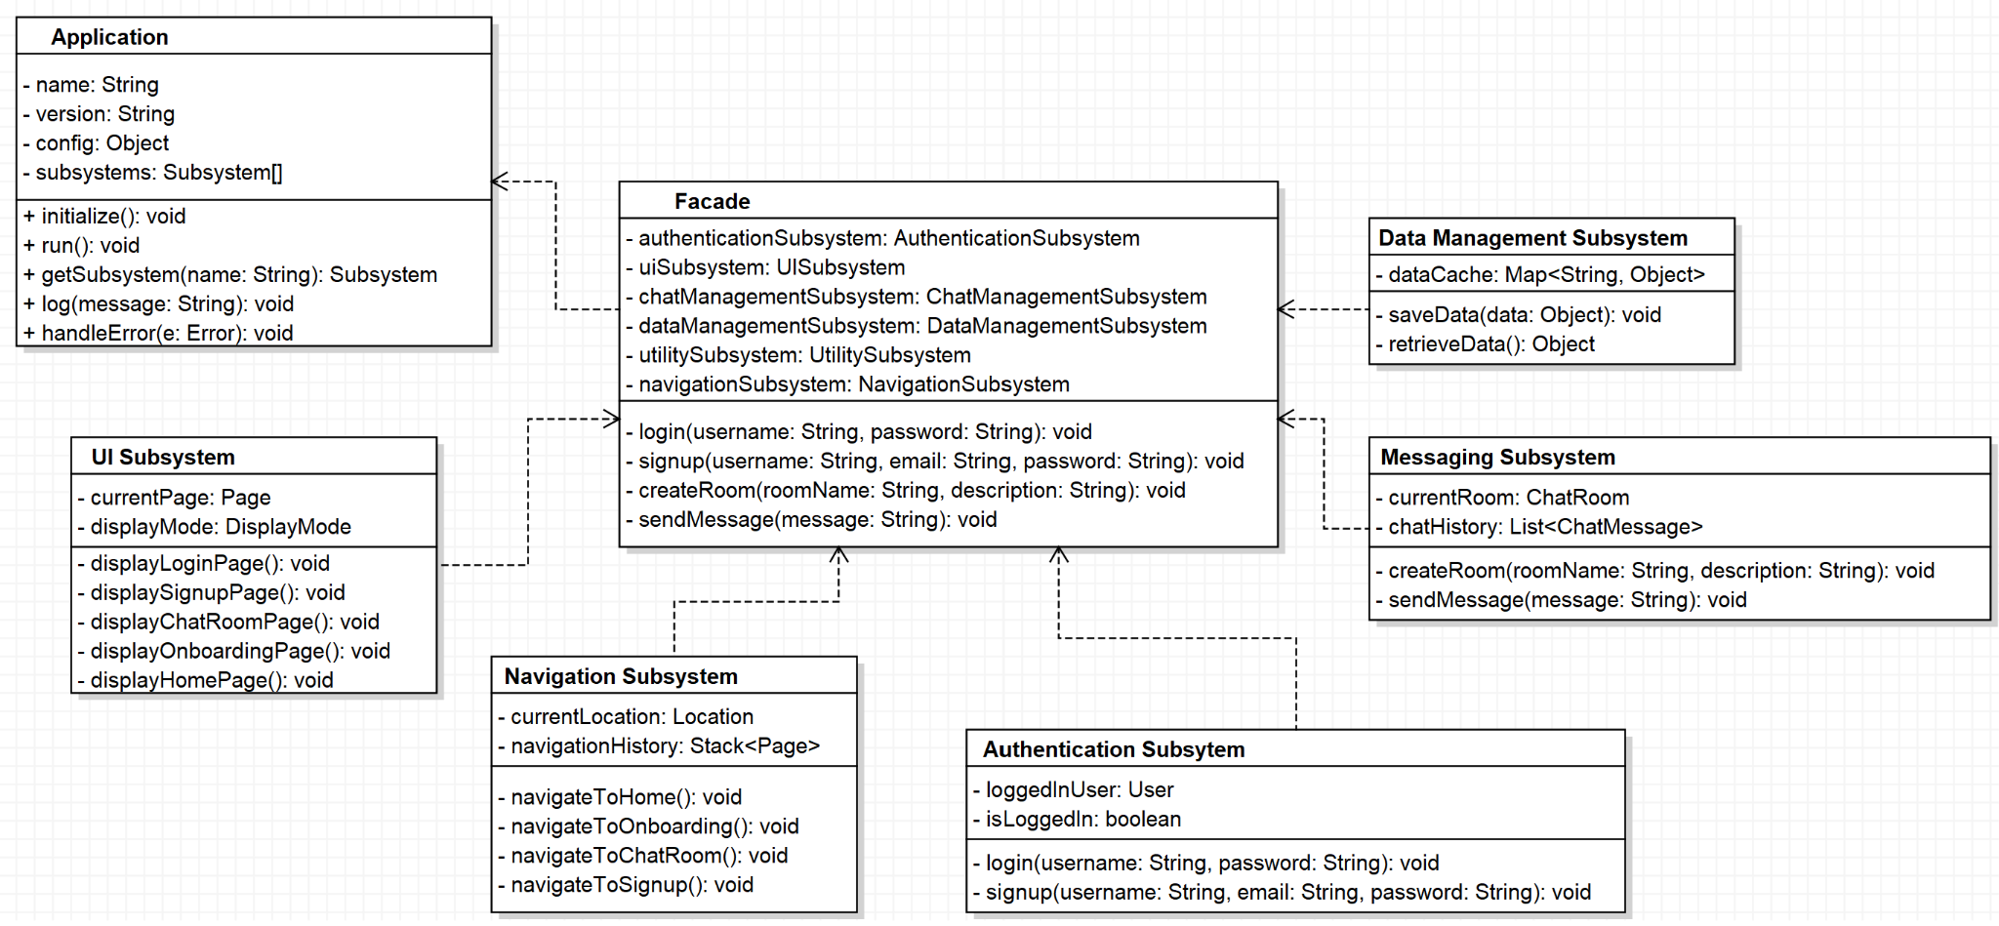
Architecture (Design Pattern)
Notes:
Aidan B

Slide 20
Configuration Management
Github Repository: https://github.com/ChatMaps/ChatMaps
Current Version: V1.0.1 (Usability Patch 1)
Release Scheme (Incremental Model)
[major release] . [minor release] . [bug/security patch]
Key Tools Used
Github (Distributed Control Management System)
Vercel (Preview, CI/CD, Web Application Distribution)
Firebase (Database, Authentication, File Storage)
React (Frontend, Backend)
Notes:
Nick P

Slide 21
Test Plan
Use Case Tests
Login by Typing Valid Credentials
Add Friend by Selection
Create a Room
Accept a Friend Request
Join a Room
Notes:
Nick P

Slide 22
Test Plan
Unit Tests
Test Case 5 (Code)
Object: RMF (Rich Message Formatting)
Input:
Message {String} - String containing text, urls, and images
Output:
*[] React Components and Strings
Test Case 1 (Code) Object: Chat | Test Case 2 (Code) Object: ChatRoomSidebar
Test Case 3 (Code) Object: DM | Test Case 4 (Code) Object: Member
Test Case 6 Object: Friend | Test Case 7 Object: FriendRequest
Test Case 8 Object: Geo | Test Case 9 Object: Notification
Test Case 10 Object: HomePage
Example Implemented Unit Test Case
import { RMF } from "../src/components/app/datatypes";
import renderer from 'react-test-renderer';
var message = "Hello, World! This is a test message. https://www.google.com"
it('RMF Renders Correctly', () => {
const tree = renderer
.create((RMF(message)))
.toJSON();
expect(tree).toMatchSnapshot();
});
Notes:
Nick

Slide 23
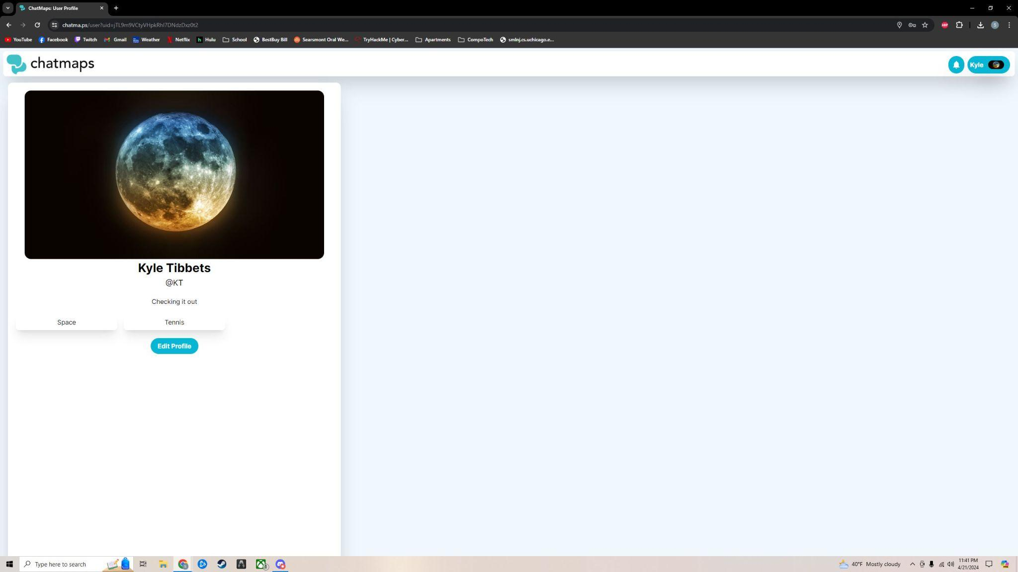
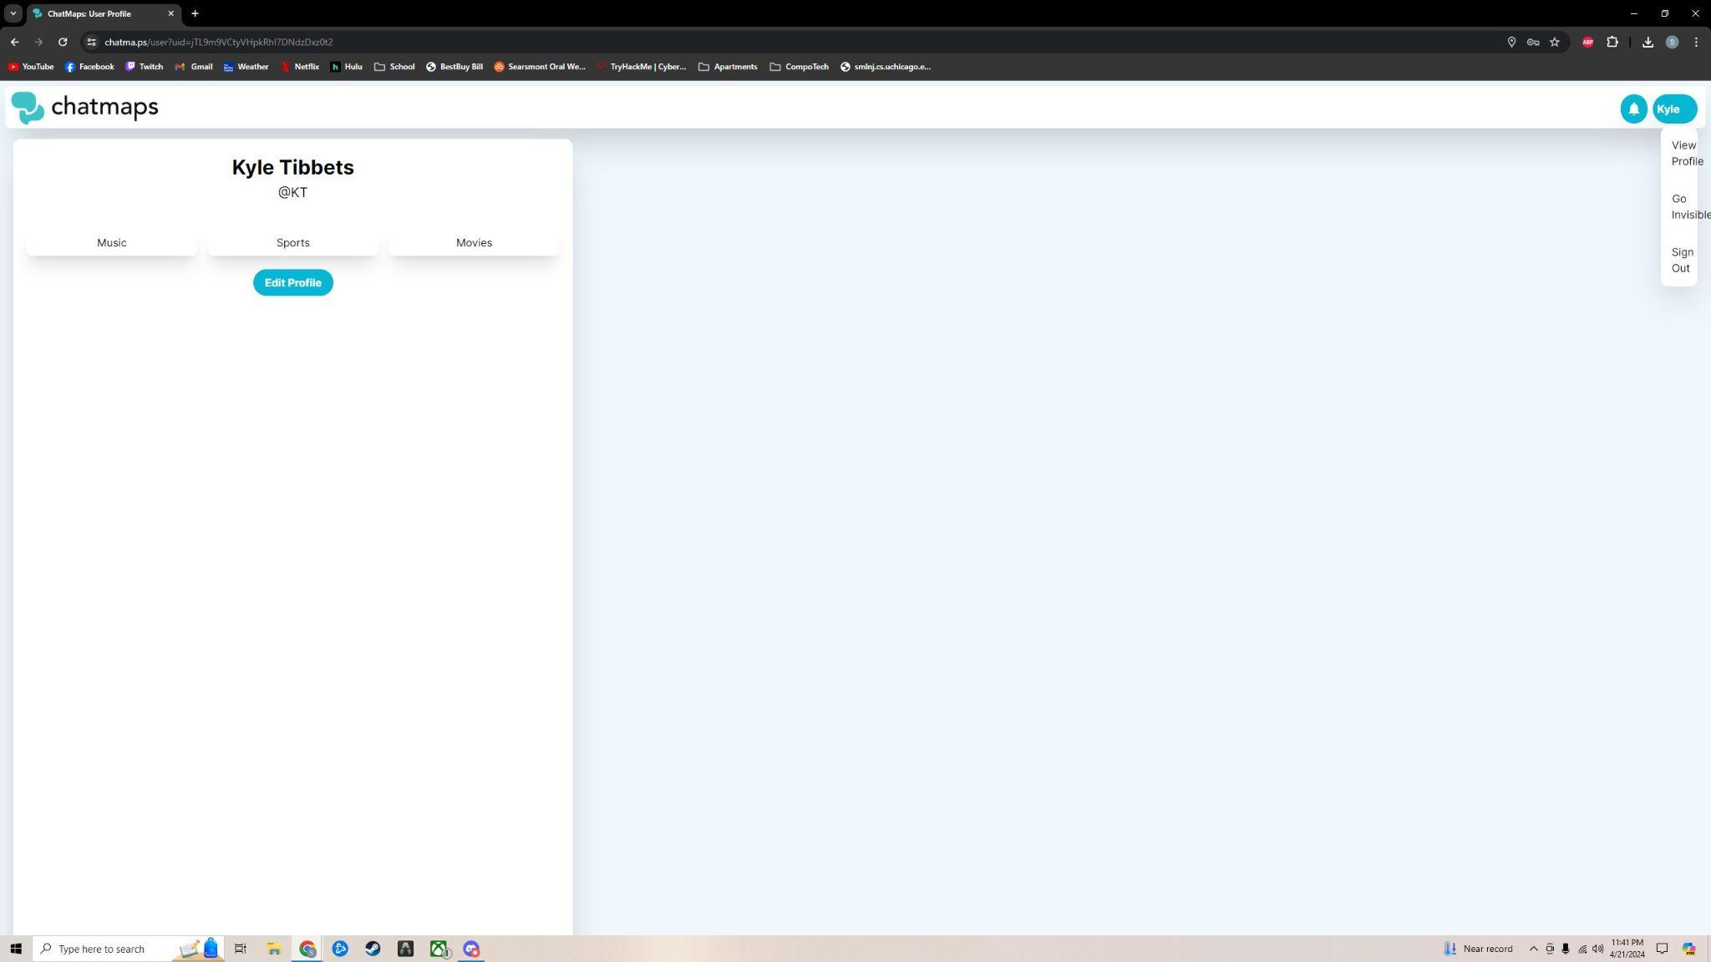
Test Plan
Acceptance Testing
User: Kyle Tibbets Feedback:
Easy to navigate UI
Very customizable profile page
Liked the GIF feature in chat rooms
Small bugs around dropdown menu size when no profile picture is added.
Notes:
Stephen G

Slide 24
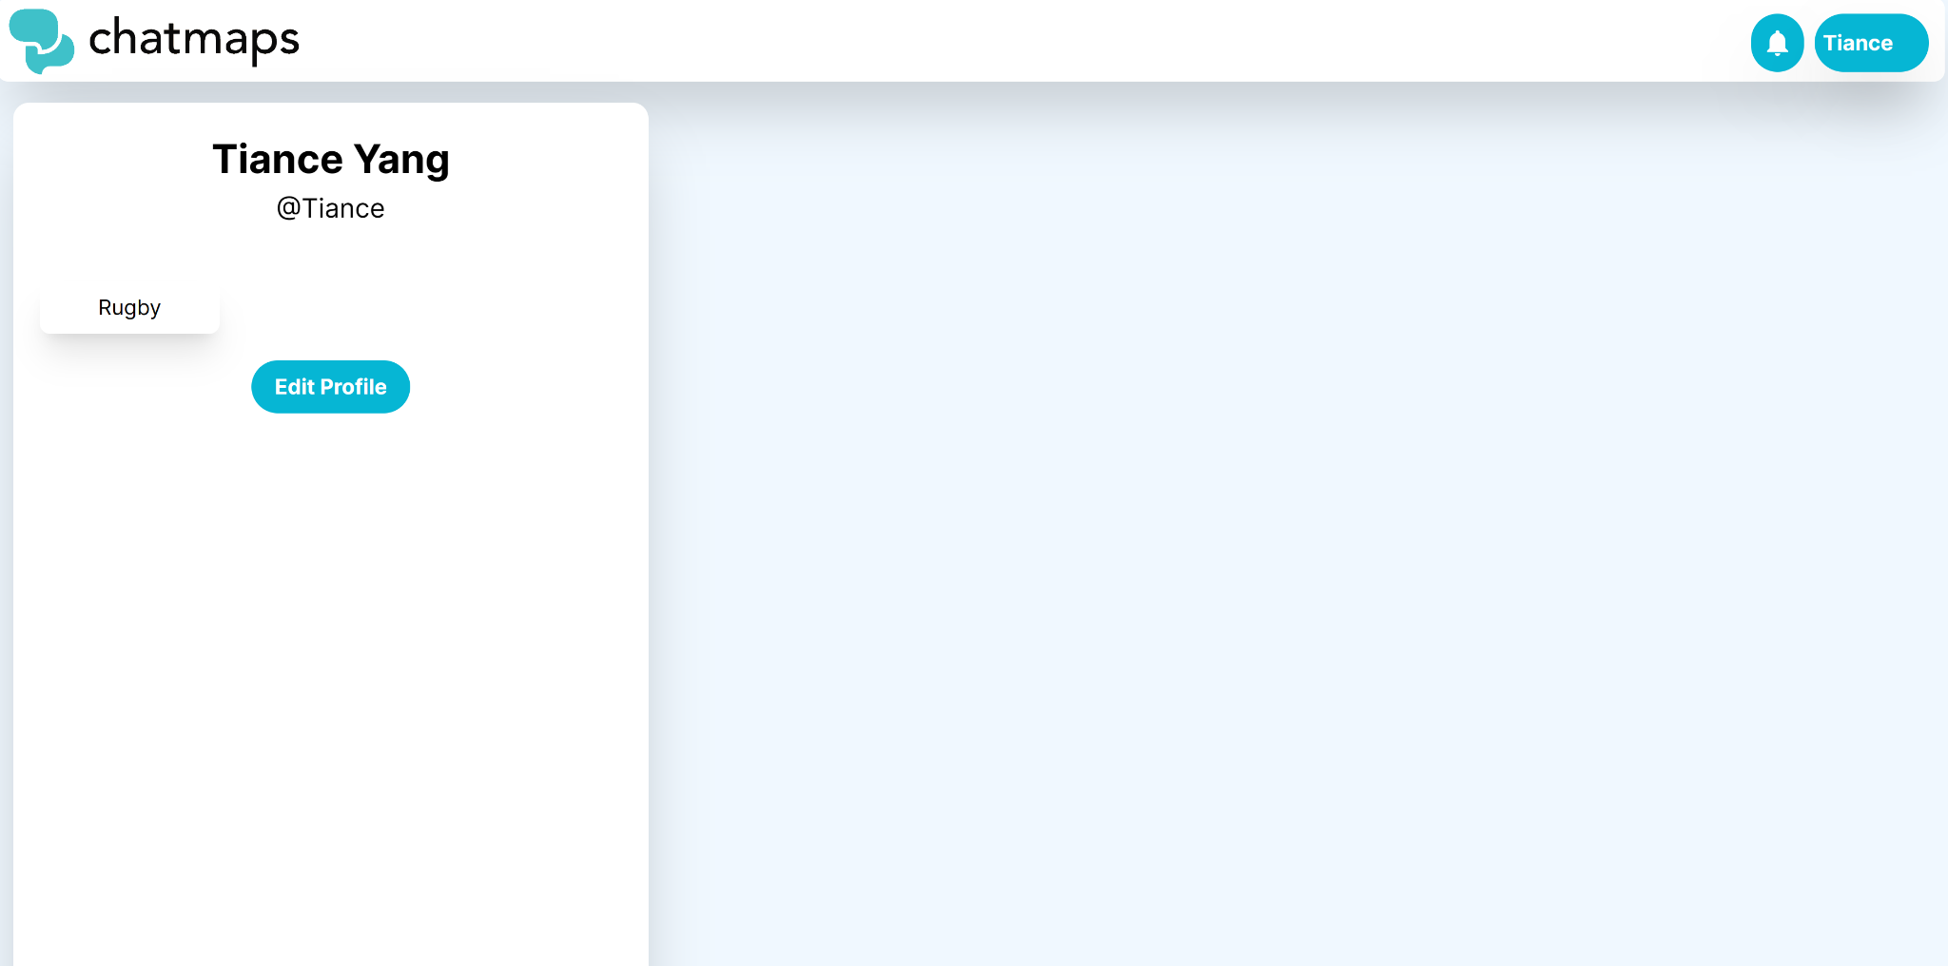
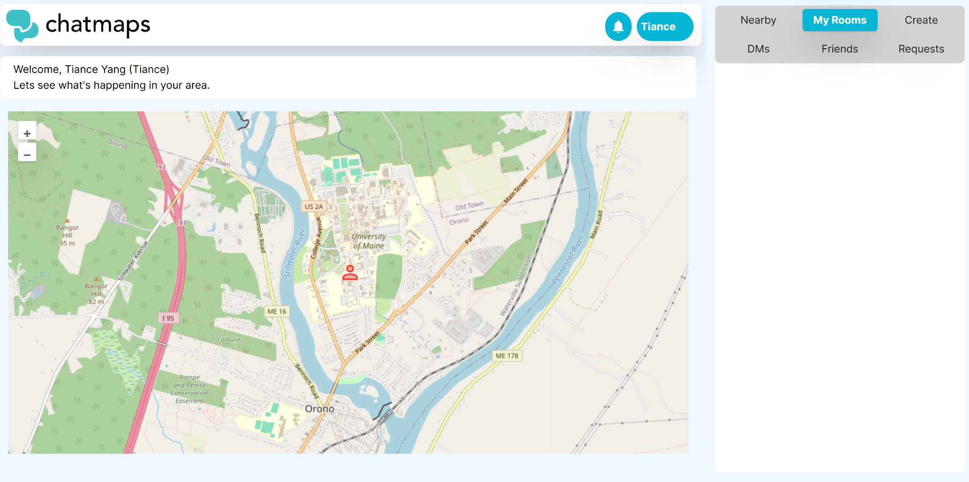
Test Plan
Acceptance Testing
User: Tiance Yang
Feedback:
Easy to create an account
Nice features, intuitive interface
Map feels empty. Could do more on it
The chats are really smooth and work well
Notes:
Aidan B

Slide 25
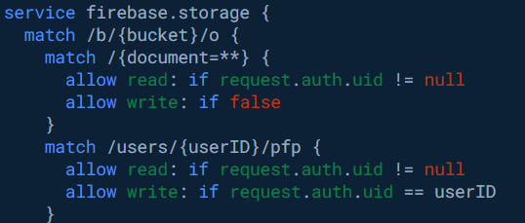
Security & Privacy
Security and privacy are major concerns while implementing a social platform such as ChatMaps
As such, the entire application (save for the first page) utilizes Firebase authentication services to handle keeping track of the users authentication across tabs and the site.
Each page individually verifies authentication status is current before completing connection
On very important pages such as profile editing and DM’s, additional checks are implemented to verify the correct users are accessing those pages / elements.
Database access is governed at a server level by access restrictions, restricting users from editing information they are not authorized to, in addition to preventing unauthorized deletions.
Profanity filters are implemented on the chat side, preventing most lewd or profane messages from being shown to the user.
Example of Firebase access restriction rules for the profile picture storage backend
Notes:
Nick
Firebase Access Restrictions (Cloud)
Profanity Filter On Chat Messages
Additional checks on DM pages

Slide 26
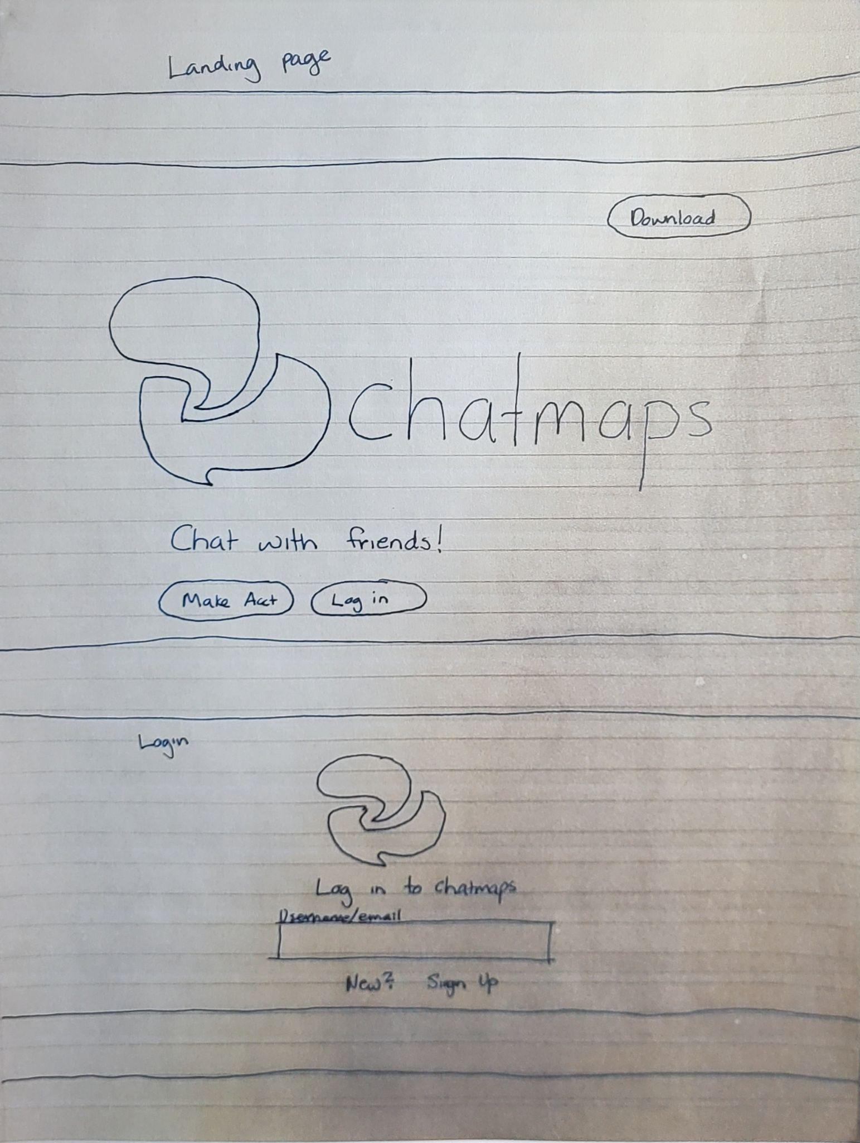
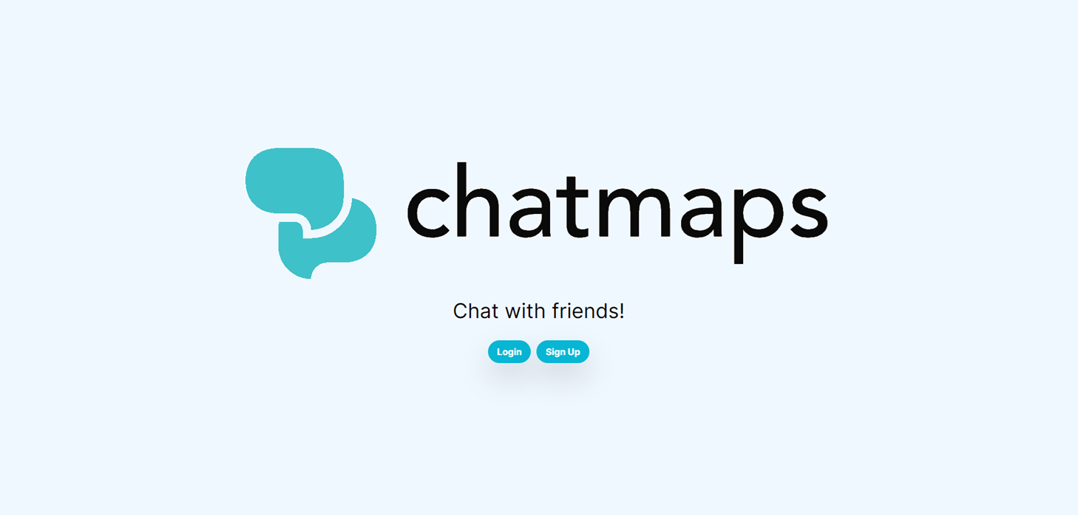
Mockups (1/3)
Notes:
Clark

Slide 27
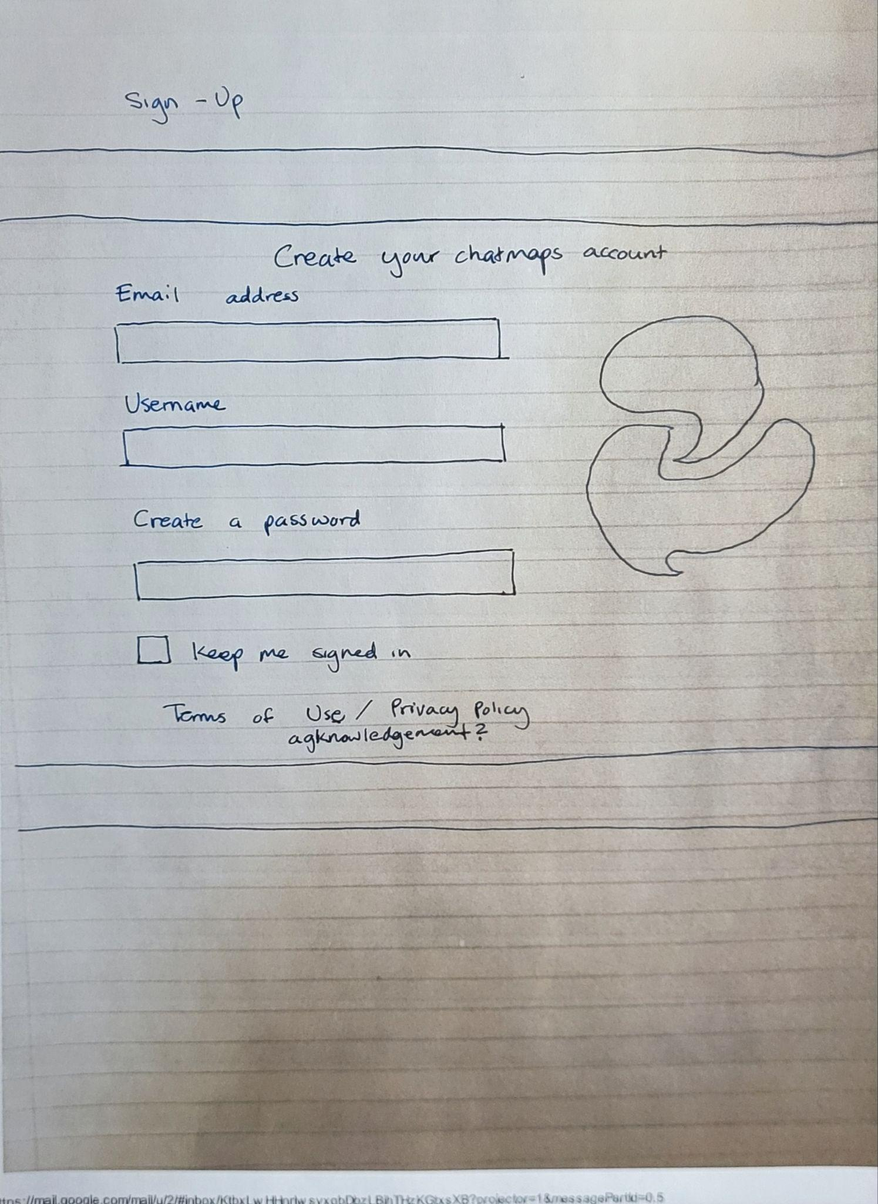
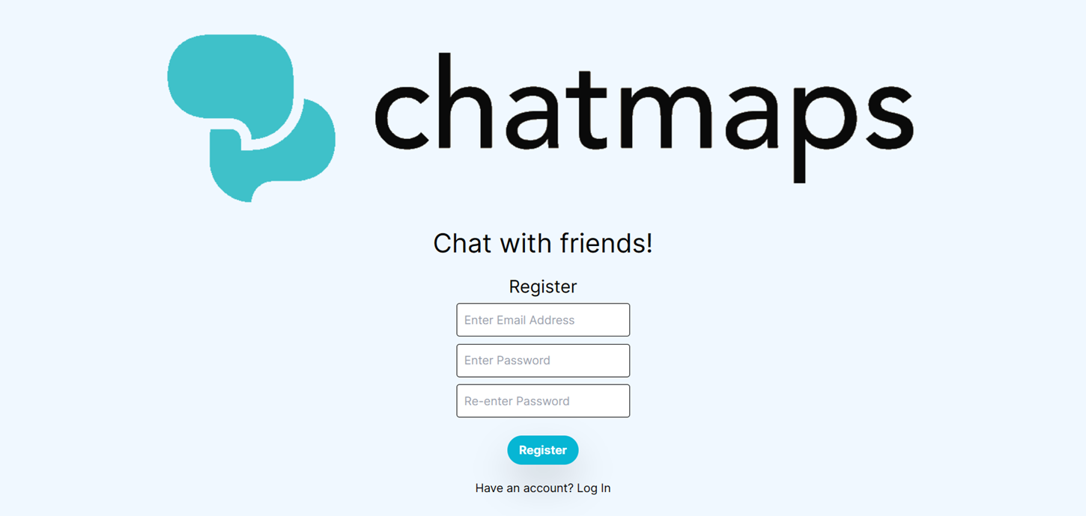
Mockups (2/3)
Notes:
clark

Slide 28
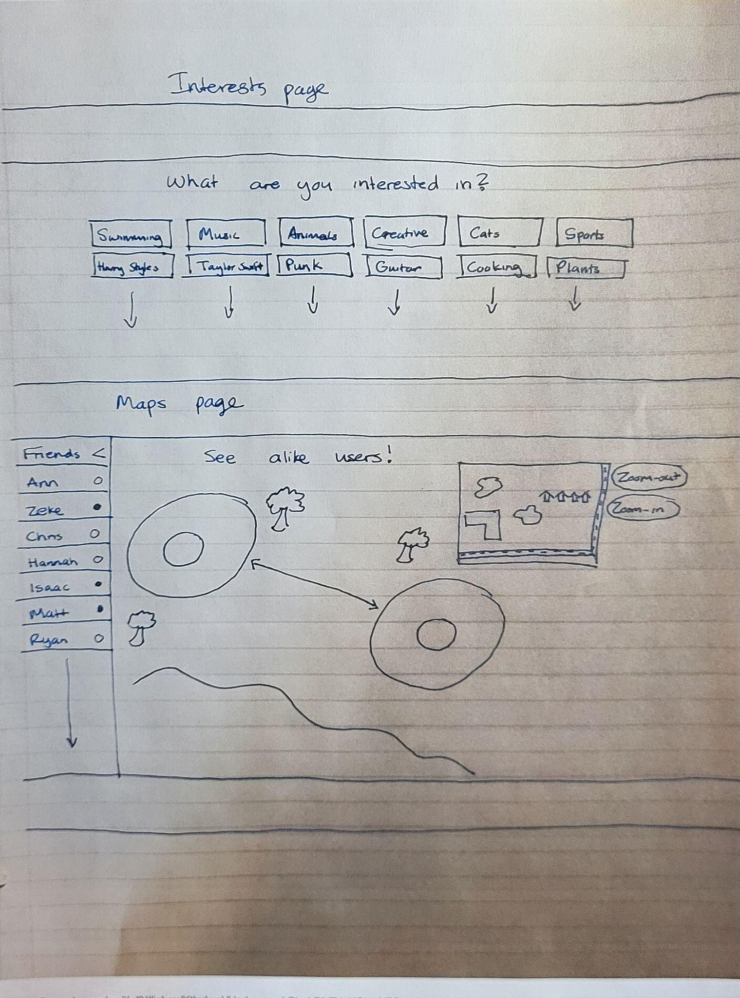
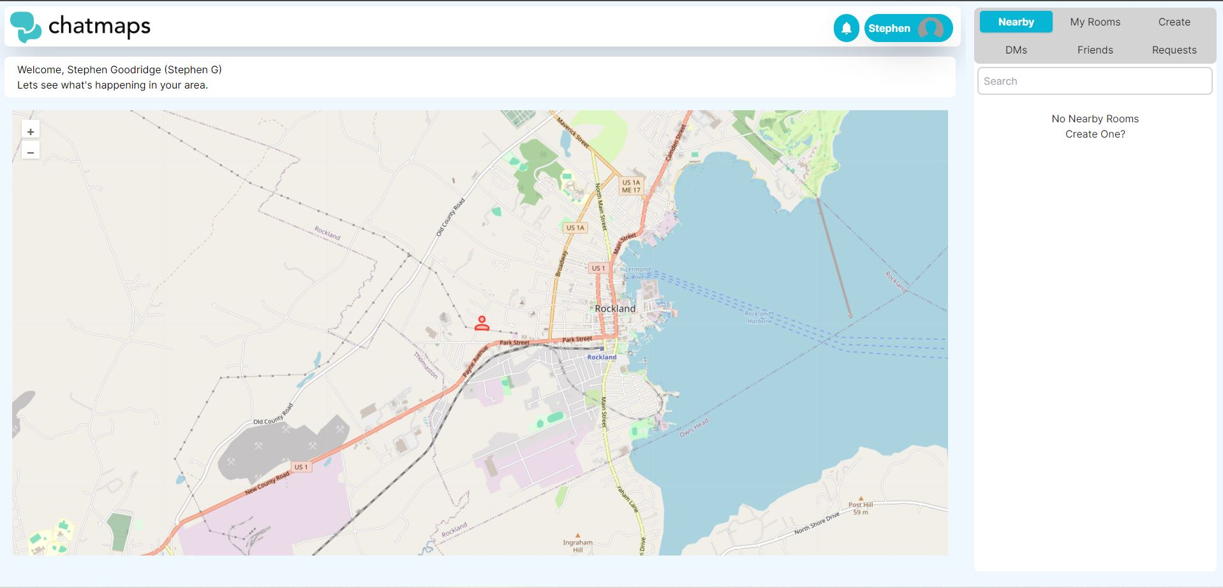
Mockups (3/3)
Notes:
Clark

Slide 29
Workload Distribution
Nick - 30%
Clark - 20%
Stephen - 20%
Aidan - 15%
Joe - 15%
Notes:
Clark

Slide 30
Future Plan
Chatmaps team finished all the user stories we set out to do
While we’ve reached our goals, there’s still some room for improvement and refinement.
The team has plans to enhance the user experience and focus on quality of life improvements that won’t disrupt the functionality of our system.
Examples:
Ability to lookup users by username for easy friend requesting
Add features to the map to help it not feel so ‘empty’.
Notes:
Stephen

Slide 31
Try now: chatma.ps
Source code available at: https://github.com/ChatMaps/ChatMaps
Notes:
Clark

Slide 32
Thank you!
Notes:
Clark

Slide 33
Demo
Notes:
Clark/Nick (10ish minutes)

